Slide 1


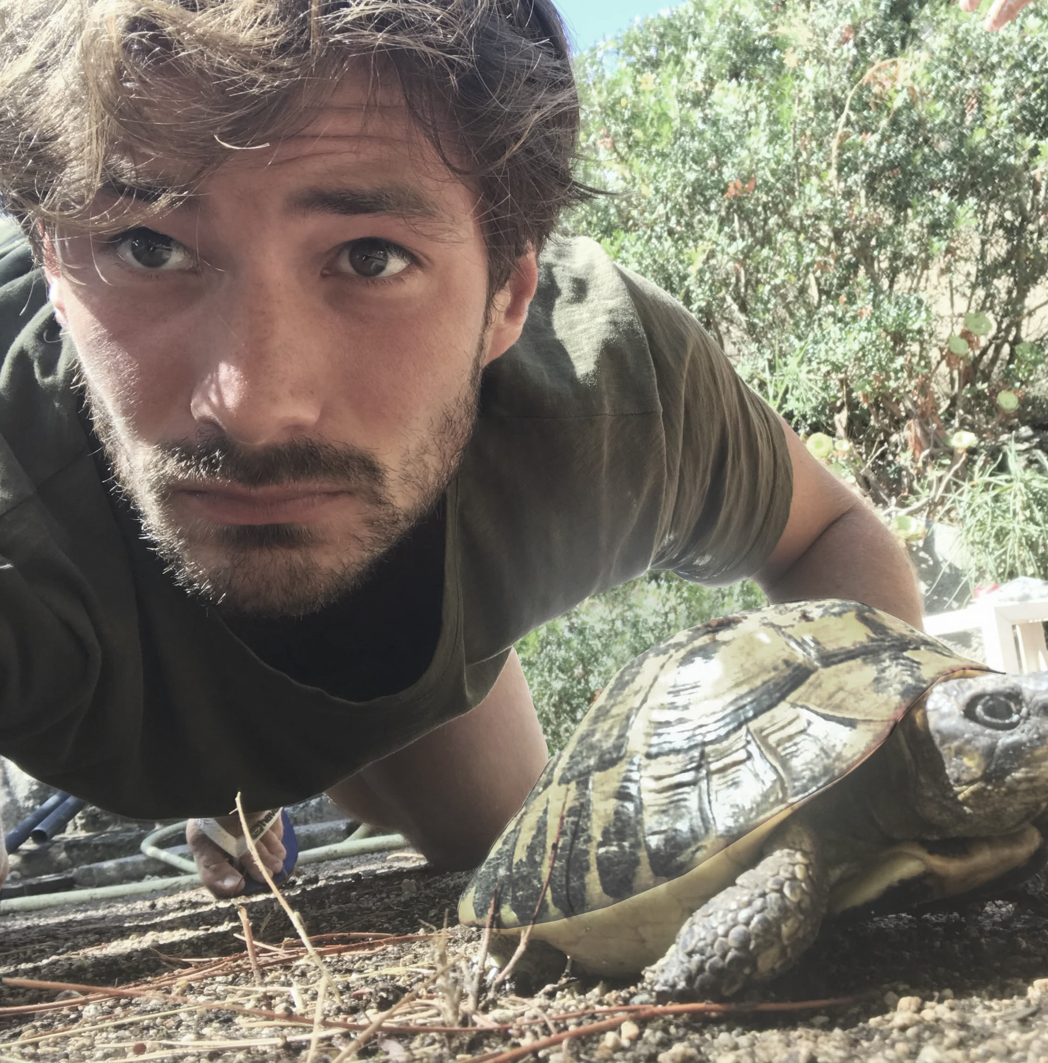


SGD with large step sizes learns sparse features (ICML 2023)
Maksym Andriushchenko
Aditya Varre
Loucas Pillaud-Vivien
Nicolas Flammarion
École Polytechnique Fédérale de Lausanne (EPFL)
Main theme: we know that SGD has a strong implicit regularization effect, but what does it imply for the features learned by the model?
23 August 2023
ELLIS Reading Group on Mathematics of Deep Learning
ICML | 2023

Slide 2
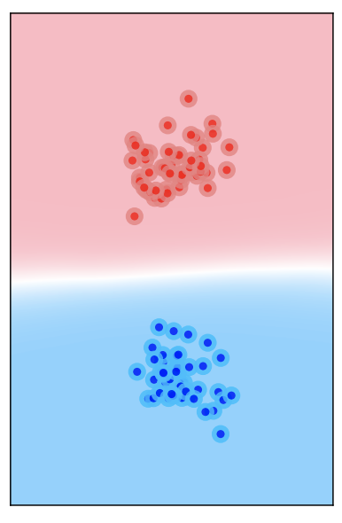
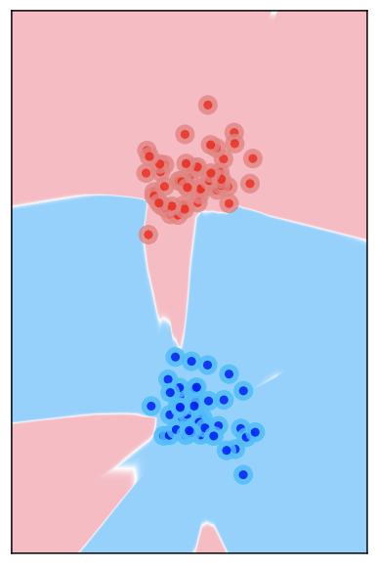
Big picture: understanding the generalization puzzle
in overparametrized deep learning
Underparametrized DL: training loss / perplexity already correlates very well with generalization! In most cases: we just need to minimize the training loss
Overparametrized DL: different global minima can generalize very differently, so it matters which one we pick (via the opt. algorithm, initialization, regularization, etc)
vs.
“Bad Global Minima Exist and SGD Can Reach Them”, NeurIPS’19

Slide 3
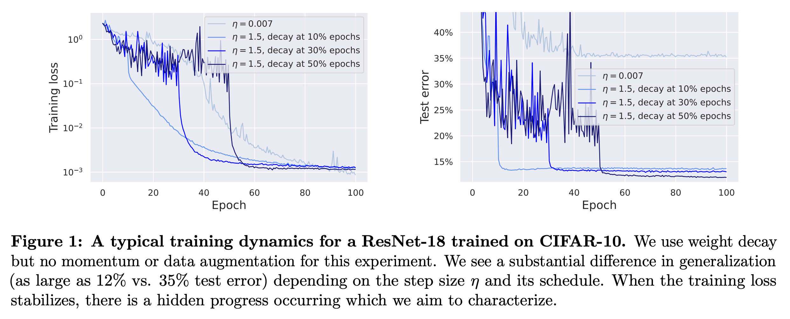
Let’s start from a known observation
Longer schedules of SGD with large step sizes lead to better generalization
Setting: ResNet-18 on CIFAR-10, standard mini-batch SGD, no data augmentation
loss
stabilization
better
generalization
This raises multiple questions:
Why does the training loss stabilizes?
What kind of hidden dynamics is happening in this phase?
How is it related to sparsity of the predictor?
Notes:
The difference can be very substantial: 35% vs. 12% test error on CIFAR-10. This suggests that something important is happening when the train loss plateaus.

Slide 4
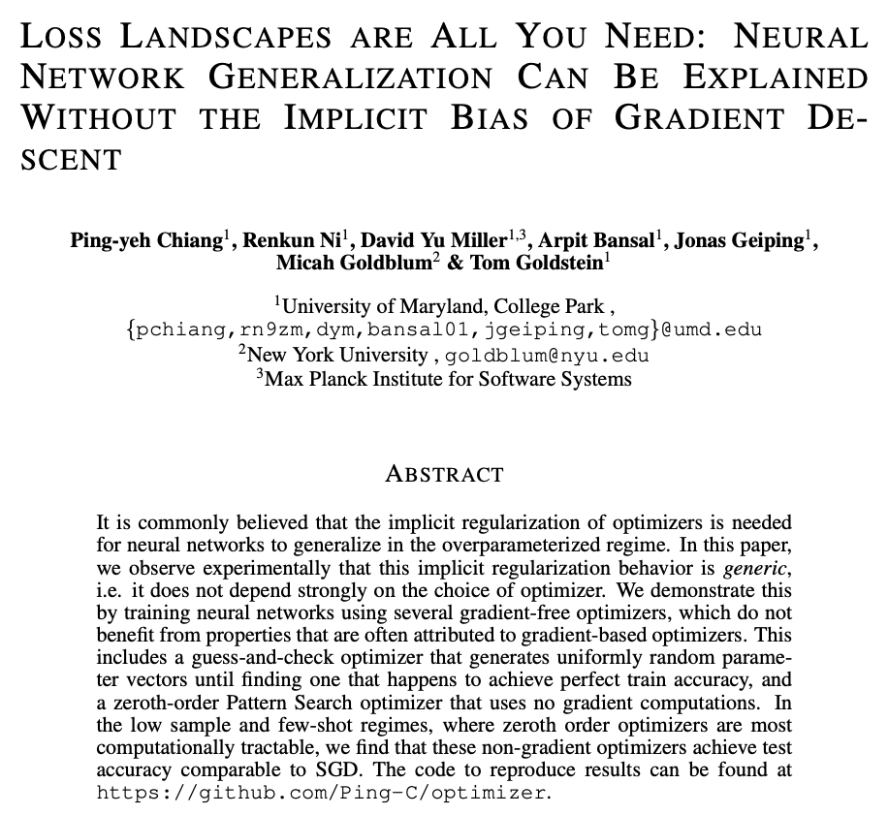
A short remark about the paper presented here in June
Quote: “we observe experimentally that this implicit regularization behavior [of optimizers] is generic, i.e. it does not depend strongly on the choice of optimizer”
Depends on what is “strongly”! There is still a consistent difference between SGD with small vs. large step sizes and we want to study that
35% vs. 12%
test error

Slide 5
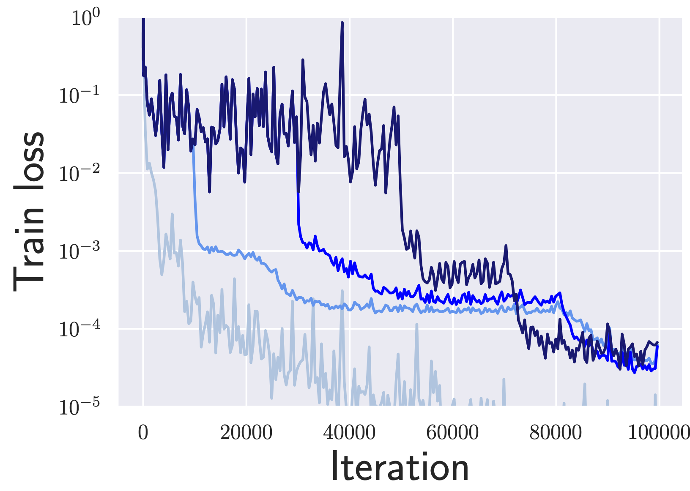
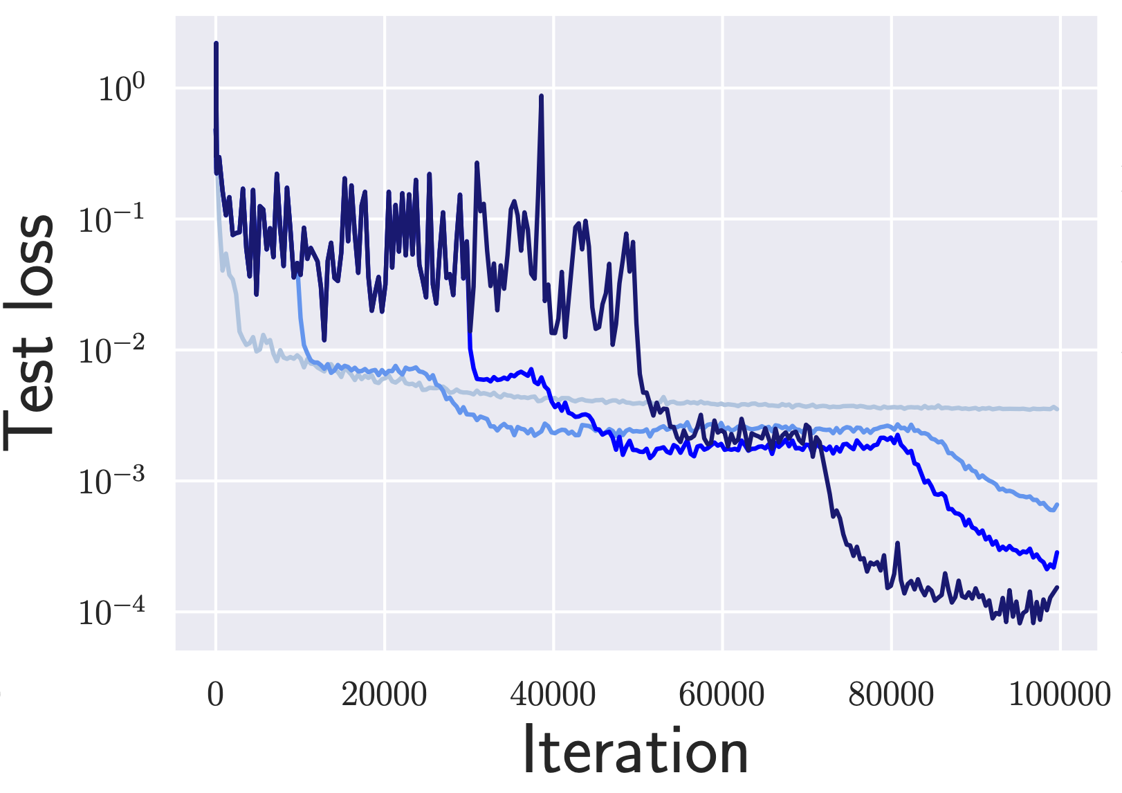
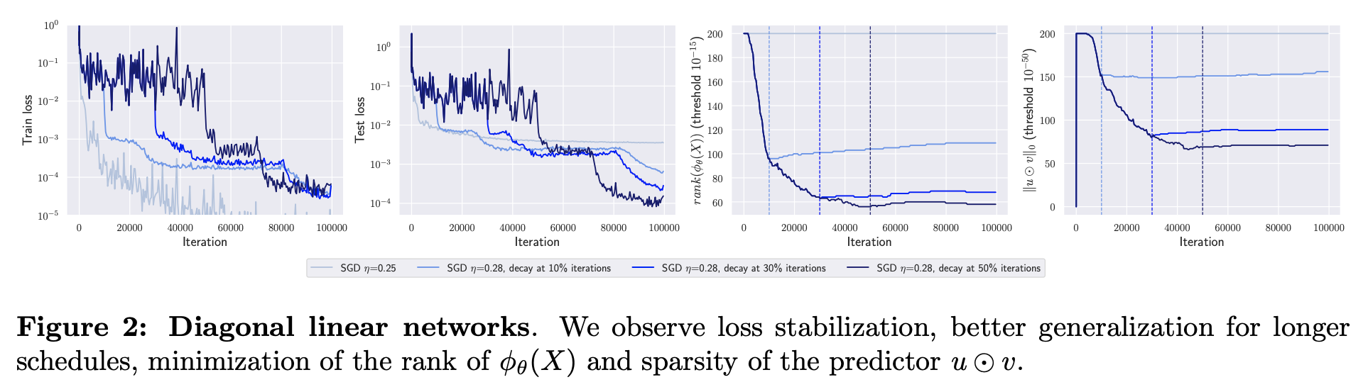

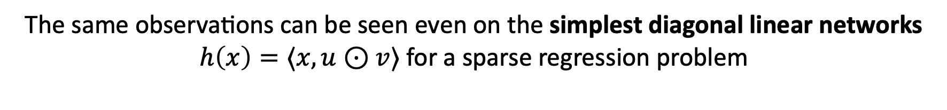
Is this a phenomenon inherent to deep networks? No!
The same observations can be seen even on the simplest diagonal linear networks $h\left(x\right)=⟨x, u⊙v⟩$ for a sparse regression problem
$⇒$ we can try to understand the phenomenon theoretically by
leveraging prior works on this toy model
Notes:
- It’s a clean setting without bells and whistles (no explicit regularization, no batch normalization, no depth, no non-linearity)
- At the same time, DLNs are interesting since they show different generalization depending on the initialization scale and SGD noise

Slide 6
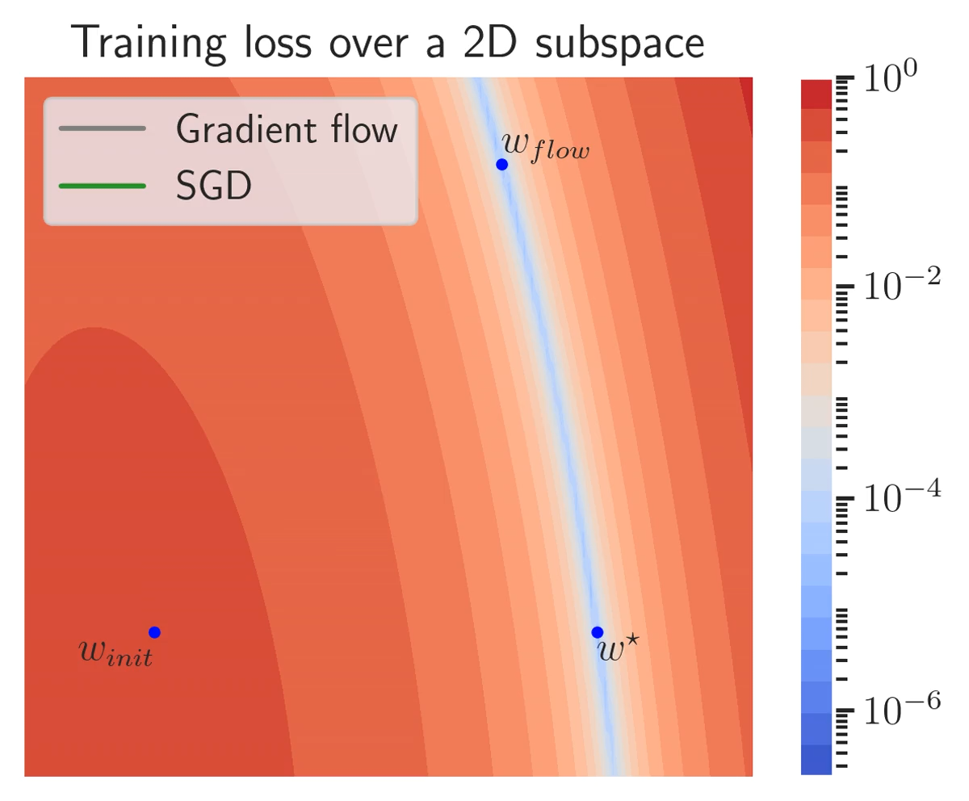
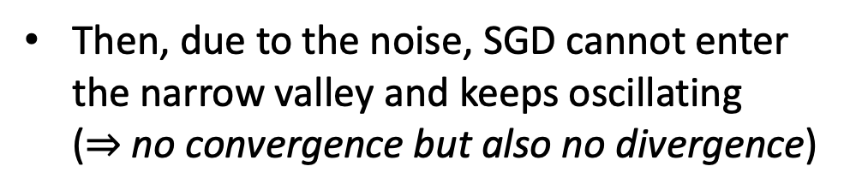
How can the training loss stabilize around some level set?
General picture:
Initially, the training loss decreases
Then, due to the noise, SGD cannot enter the narrow valley and keeps oscillating
($⇒$ no convergence but also no divergence)
We formalize it in the paper with a proposition that describes how this can occur provably for a 1D diagonal linear net
In addition, it’s apparent that SGD slowly moves to a certain direction. Can we better understand that?
Setting: a 2-D slice of the 60-D training loss surface of a diagonal linear network
Notes:
First, SGD can be seen as GD + specific label noise whose strength scales with training loss.
Hence, when the loss stabilizes at some level set, SGD is equivalent to GD + *constant* label noise, and this modeling can be leveraged to capture dynamics of large step size SGD.

Slide 7
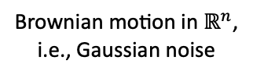

Modelling SGD with a Stochastic Differential Equation (Part I)
Observation: the noise intensity of SGD is proportional to the training loss
$⇒$ when the loss stabilizes, we can assume constant noise intensity
Thus, we can model the large step size SGD phase with the following constant-noise SDE:
constant noise intensity due to loss stabilization
step size
Constant-noise SDE:
Brownian motion in $ℝ^{n}$,
i.e., Gaussian noise
the Jacobian of the network $[{∇_{θ}h}_{θ}{\left(x_{i}\right)}^{⊤}]_{i=1}^{n}∈ℝ^{n×p}$
We check empirically that this SDE fully agrees with SGD in terms of the generalization improvements and other key metrics (we’ll see these experiments later)
This SDE can be seen as the effective slow dynamics (due to the gradient + the noise term) that drives the $θ_{t}$ while they bounce rapidly due to the noise (fast dynamics)
Notes:
This dynamics can be understood via an SDE ⬇️. For diagonal networks, it provably leads to sparse solutions. We conjecture that sparsity is at play also for arbitrary ReLU nets. To support this, we track related quantities during training for various architectures.

Slide 8


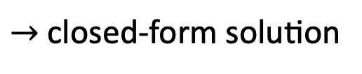
Modelling SGD with a Stochastic Differential Equation (Part II)
Constant-noise SDE:
Prior works: for diagonal linear networks, Pillaud-Vivien et al. (COLT 2022) proved the sparsity of the solution using a similar SDE derived for label noise SGD
Our work: we conjecture that for arbitrary deep networks, a similar sparsifying effect is taking place for standard SGD with large step sizes (no label noise needed)
  Observation: for the Brownian motion $dB_{t}∈ℝ^{n}$: $φ_{θ_{t}}{\left(x_{i}\right)}^{⊤}{dB}_{t}=||φ_{θ_{t}}(x_{i})||_{2}{dW}_{t}$ where ${dW}_{t}∈ℝ$ is a 1D Brownian motion (basic property of the Gaussian distribution)
  Thus, the SDE resembles the geometric Brownian motion (Oksendal, 2013):
$$dθ_{t}=μθ_{t}dt+δθ_{t}dW_{t}$$
$→$ closed-form solution
$$θ_{t}=θ_{0}exp⁡((μ−δ^{2}/2)t+δW_{t})$$
  Thus, we expect the SDE to induce a similar shrinkage effect for each multiplicative fac-tor to ${dW}_{t}$, i.e., $||φ_{θ_{t}}\left(x_{i}\right)||_{2}$ with strength proportional to the loss stabilization level $δ$
Notes:
This dynamics can be understood via an SDE ⬇️. For diagonal networks, it provably leads to sparse solutions. We conjecture that sparsity is at play also for arbitrary ReLU nets. To support this, we track related quantities during training for various architectures.

Slide 9
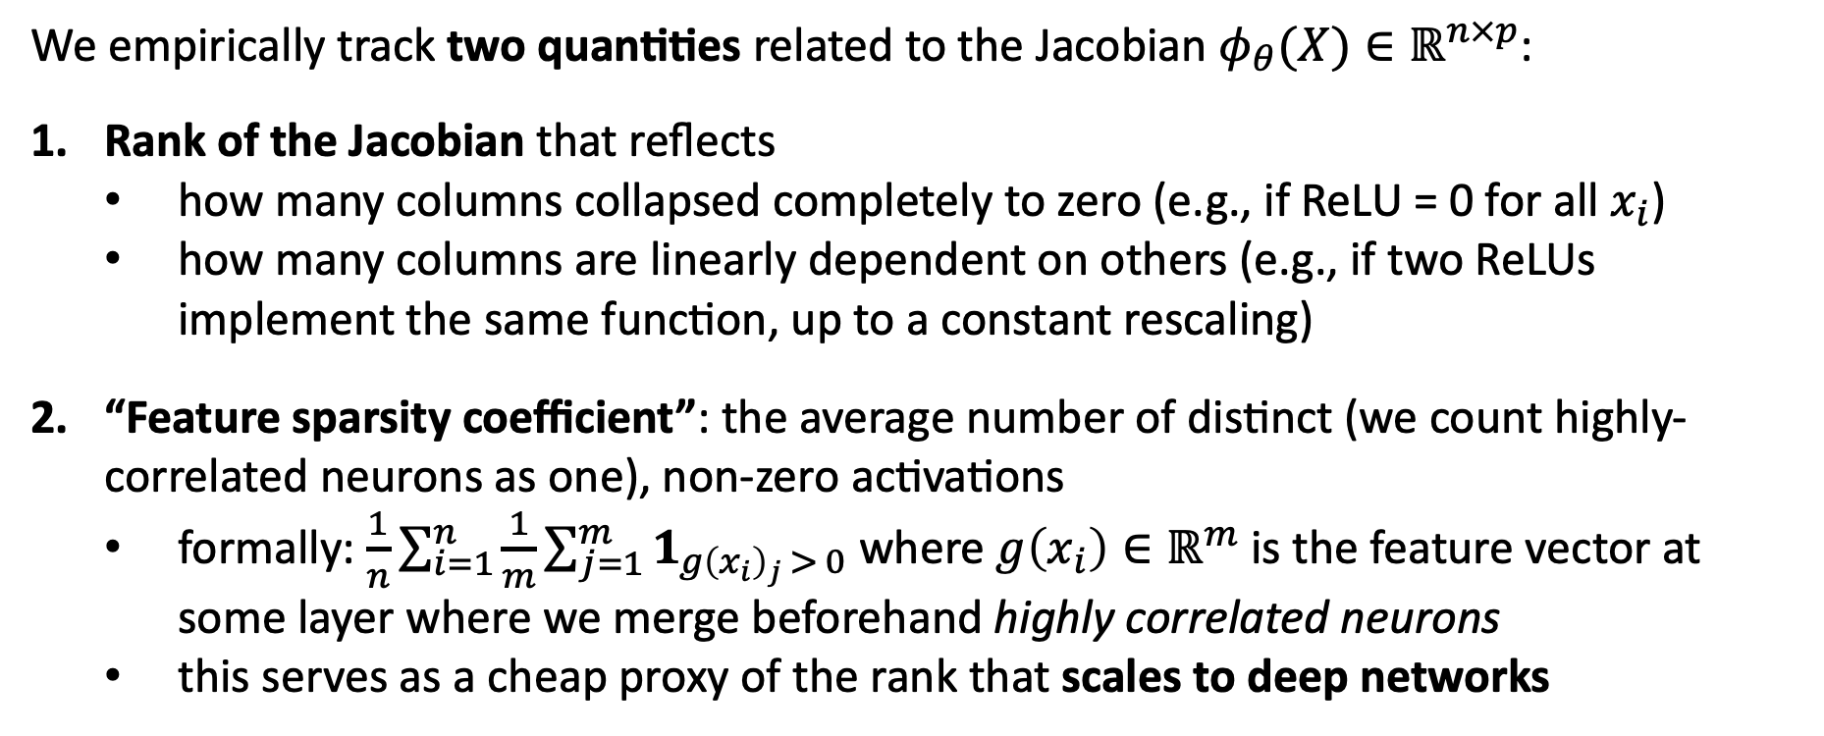
Notions of sparsity for arbitrary architectures
Constant-noise SDE:
We empirically track two quantities related to the Jacobian $φ_{θ}(X)∈ℝ^{n×p}$:
Rank of the Jacobian that reflects
  how many columns collapsed completely to zero (e.g., if ReLU = 0 for all $x_{i}$)
  how many columns are linearly dependent on others (e.g., if two ReLUs implement the same function, up to a constant rescaling)
“Feature sparsity coefficient”: the average number of distinct (we count highly-correlated neurons as one), non-zero activations
  formally: $\frac{1}{n}\sum_{i=1}^{n}{\frac{1}{m}\sum_{j=1}^{m}{1_{g{\left(x_{i}\right)}_{j} > 0}}}$ where $g\left(x_{i}\right)∈ℝ^{m}$ is the feature vector at some layer where we merge beforehand highly correlated neurons
  this serves as a cheap proxy of the rank that scales to deep networks
Notes:
This dynamics can be understood via an SDE ⬇️. For diagonal networks, it provably leads to sparse solutions. We conjecture that sparsity is at play also for arbitrary ReLU nets. To support this, we track related quantities during training for various architectures.

Slide 10
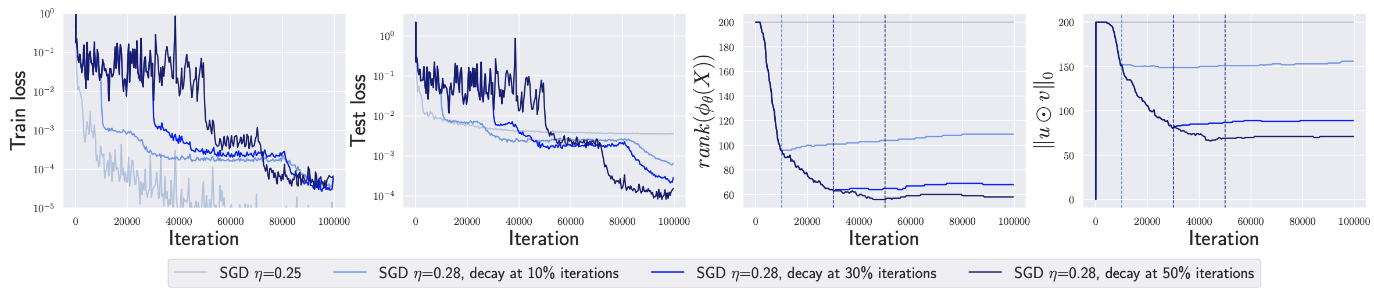
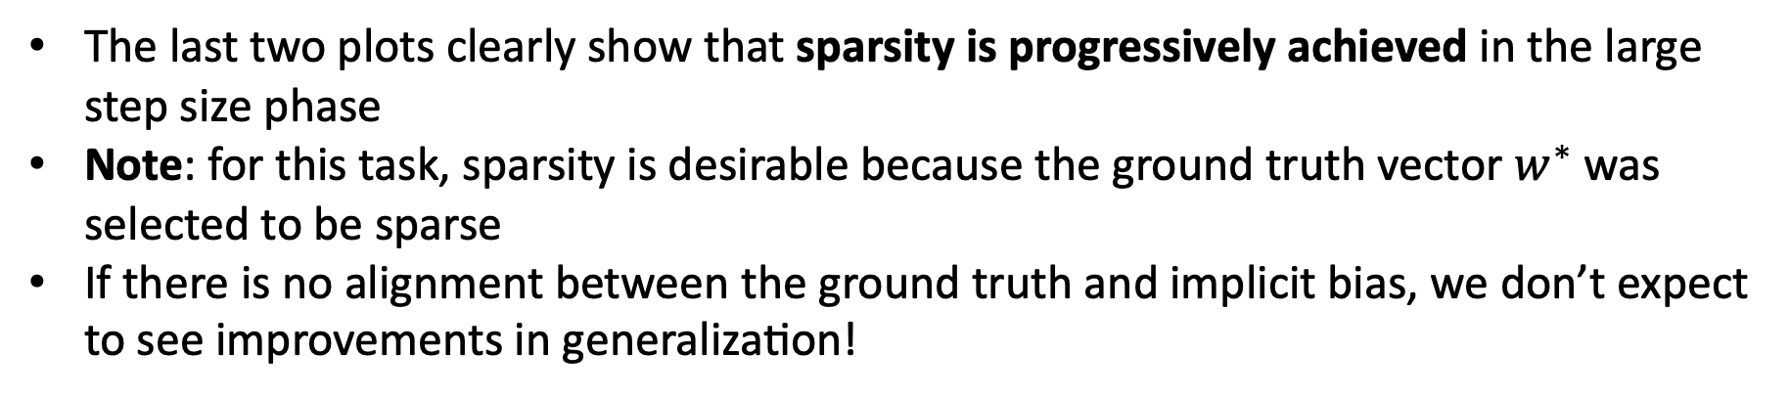
Sparse feature learning for diagonal linear networks
(the first two plots are the same as before)
(new)
(new)
The last two plots clearly show that sparsity is progressively achieved in the large step size phase
Note: for this task, sparsity is desirable because the ground truth vector $w^{∗}$ was selected to be sparse
If there is no alignment between the ground truth and implicit bias, we don’t expect to see improvements in generalization!

Slide 11
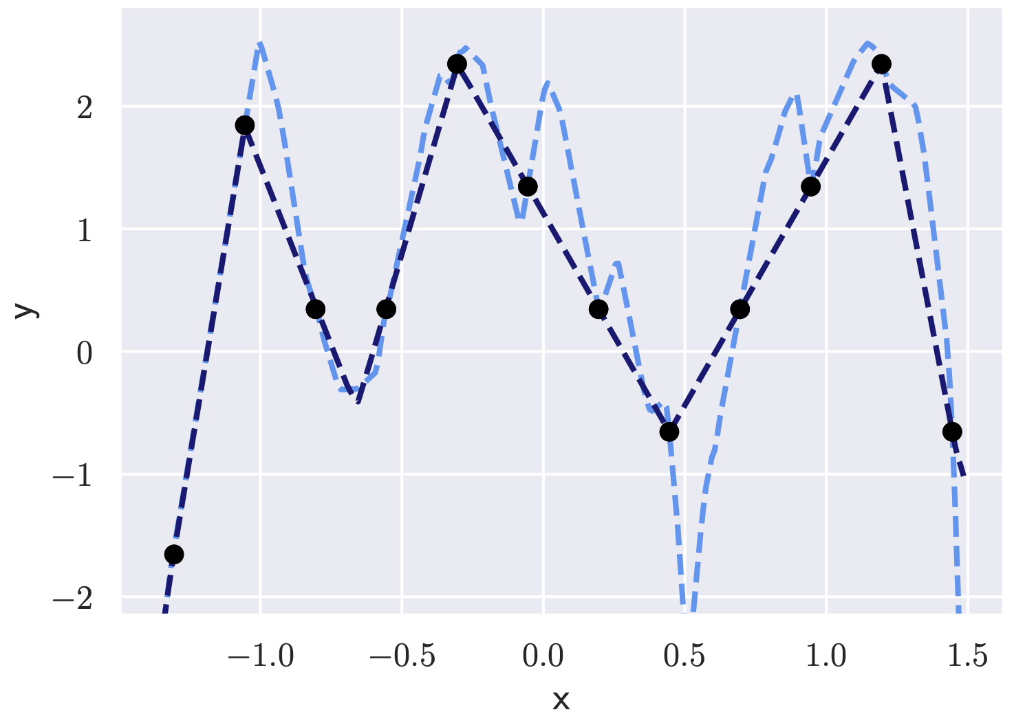
Sparse feature learning for a simple one-layer ReLU network
Illustration: a classical textbook picture about overfitting
Here, however, the nice interpolation between the points
is due to the implicit regularization effect of large step sizes

Slide 12
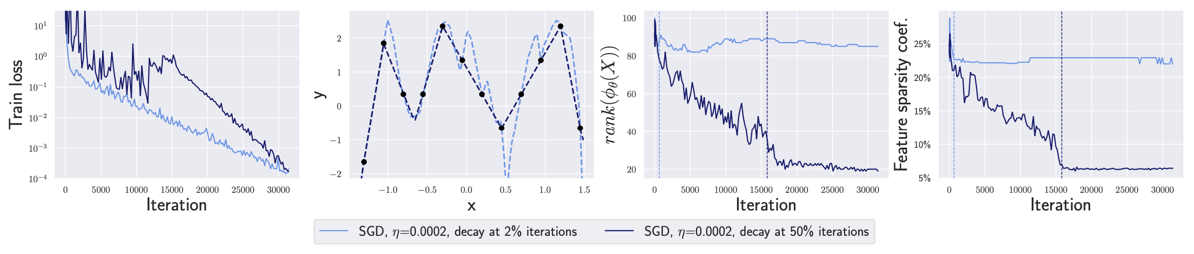
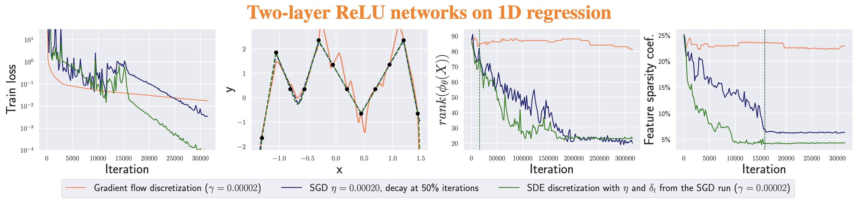
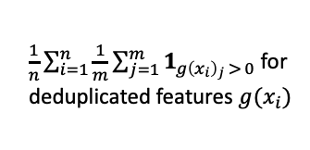
A simple one-layer ReLU network: sparsity metrics
$\frac{1}{n}\sum_{i=1}^{n}{\frac{1}{m}\sum_{j=1}^{m}{1_{g{\left(x_{i}\right)}_{j} > 0}}}$ for
deduplicated features $g(x_{i})$
Sparse feature learning
Validity of the SDE modeling
Notes:
Let’s start with a two-layer network on a simple 1D task. We can already see that the longer schedule leads to a much simpler predictor. Moreover, during the loss stabilization phase, the network is significantly simplified both in terms of rank(ϕ(X)) and feature sparsity.

Slide 13
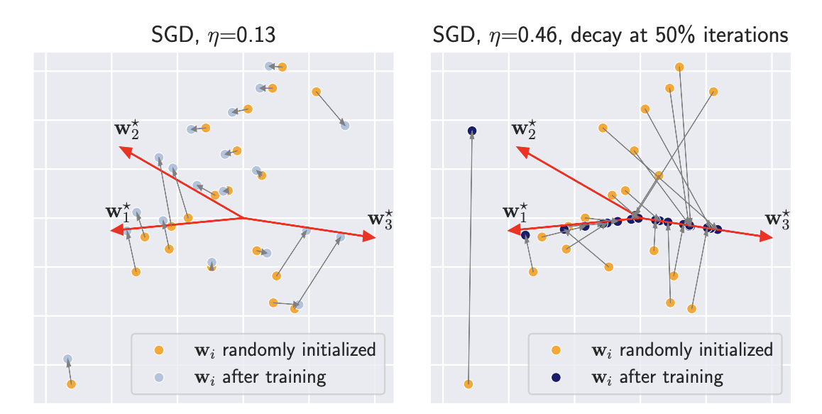
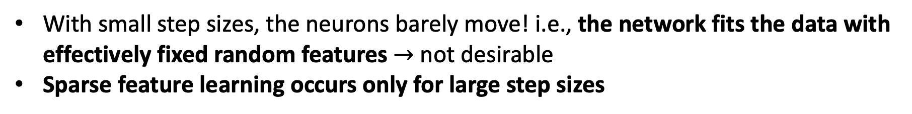
Dynamics of individual neurons in 2D
How do the weight vectors corresponding to neurons move depending on the step size?
Setting: input dimension $d=2$, teacher with 3 neurons $w_{1}^{⋆}, w_{2}^{⋆}, w_{3}^{⋆}$, student with 20 neurons
With small step sizes, the neurons barely move! i.e., the network fits the data with effectively fixed random features $→$ not desirable
Sparse feature learning occurs only for large step sizes

Slide 14
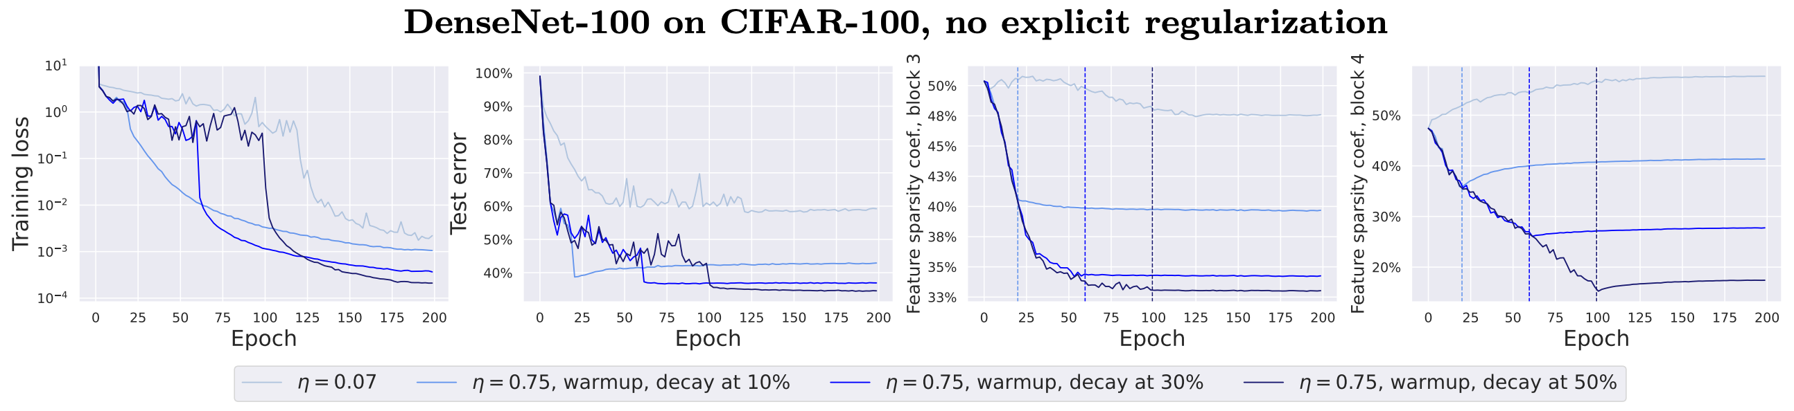
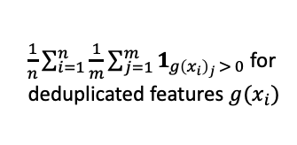
Sparse feature learning for deep networks (part I)
$\frac{1}{n}\sum_{i=1}^{n}{\frac{1}{m}\sum_{j=1}^{m}{1_{g{\left(x_{i}\right)}_{j} > 0}}}$ for
deduplicated features $g(x_{i})$
Main observations:
Plot 1: the training loss stabilizes
Plot 2: the test error noticeably depends on the length of the schedule
Plots 3 & 4: the feature sparsity coefficient at top layers (blocks 3 and 4 out of 4 blocks in total) is minimized during the large step size phase
Notes:
We see the same sparse feature learning pattern on all models we consider, incl. ResNets on CIFAR-10/100. We can’t compute rank(ϕ(X)) for them but the features at the middle/last layers become *much* sparser for large step sizes (with and without explicit regularizers).

Slide 15
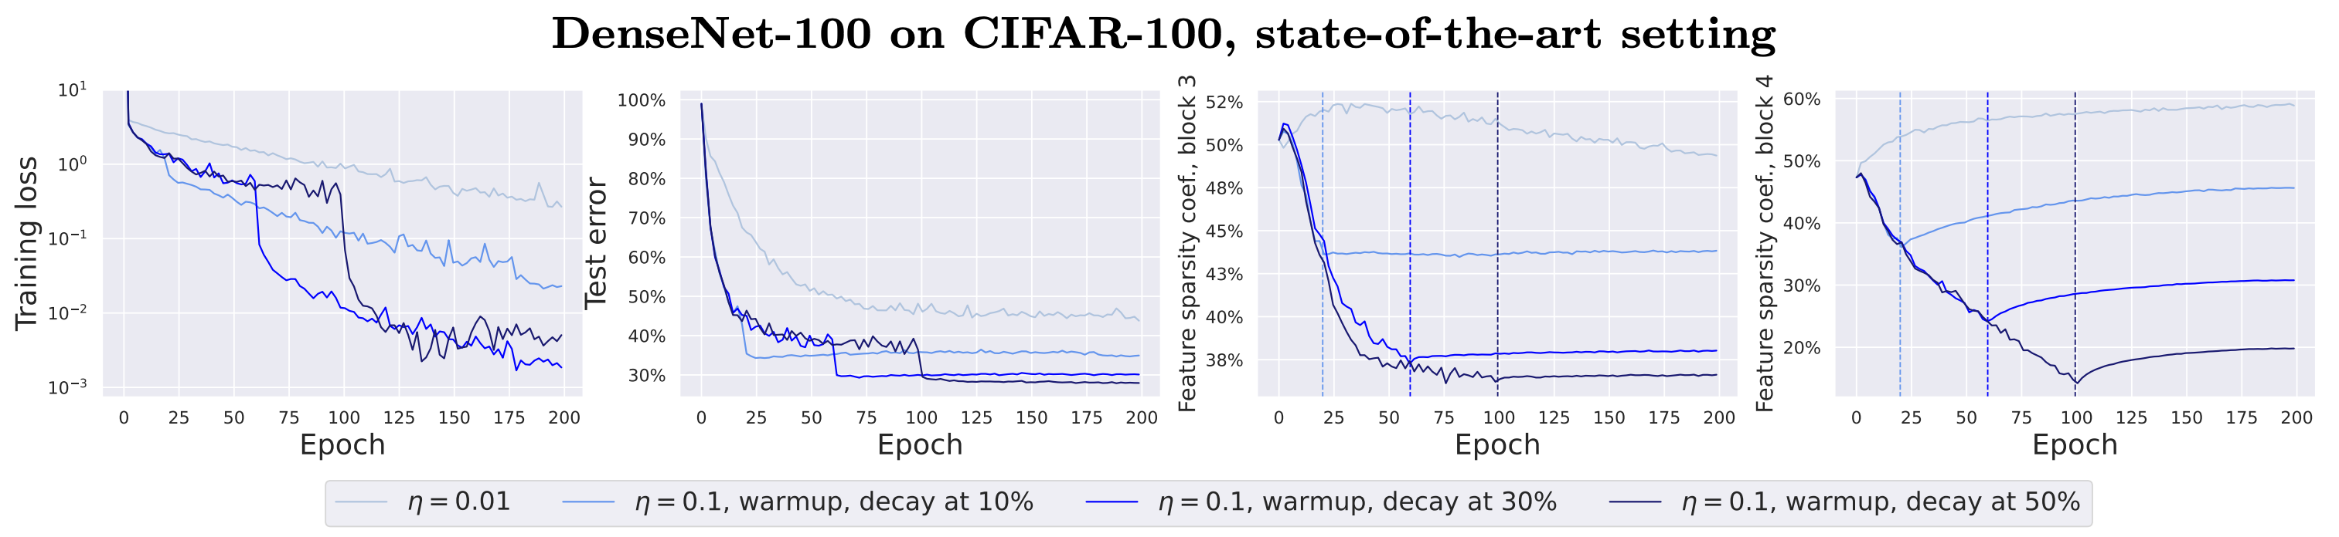
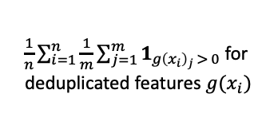
Sparse feature learning for deep networks (part 2)
$\frac{1}{n}\sum_{i=1}^{n}{\frac{1}{m}\sum_{j=1}^{m}{1_{g{\left(x_{i}\right)}_{j} > 0}}}$ for
deduplicated features $g(x_{i})$
Main observations:
Plot 1: the training loss stabilizes
Plot 2: the test error noticeably depends on the length of the schedule
Plots 3 & 4: the feature sparsity coefficient at top layers (blocks 3 and 4) is minimized during the large step size phase
Notes:
We see the same sparse feature learning pattern on all models we consider, incl. ResNets on CIFAR-10/100. We can’t compute rank(ϕ(X)) for them but the features at the middle/last layers become *much* sparser for large step sizes (with and without explicit regularizers).

Slide 16
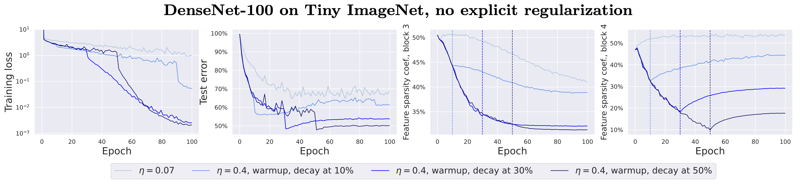
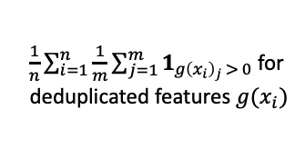
Sparse feature learning for deep networks (part 3)
$\frac{1}{n}\sum_{i=1}^{n}{\frac{1}{m}\sum_{j=1}^{m}{1_{g{\left(x_{i}\right)}_{j} > 0}}}$ for
deduplicated features $g(x_{i})$
Main observations:
Plot 1: the training loss stabilizes
Plot 2: the test error noticeably depends on the length of the schedule
Plots 3 & 4: the feature sparsity coefficient at top layers (blocks 3 and 4) is minimized during the large step size phase
Notes:
We see the same sparse feature learning pattern on all models we consider, incl. ResNets on CIFAR-10/100. We can’t compute rank(ϕ(X)) for them but the features at the middle/last layers become *much* sparser for large step sizes (with and without explicit regularizers).

Slide 17
Conclusions and takeaways
Our picture: SGD noise drives the iterates to a sparse solution which we observe on many models (from diagonal linear networks to DenseNets on Tiny ImageNet)
Sparse features are likely to be often (but surely not always) beneficial for generalization on natural data
We can learn them via the SGD dynamics if we don’t converge too early
The same training dynamics is likely to be achieved via different means but with SGD we get this effect “for free” unlike, e.g., for gradient/Jacobian regularizers
May be of interest: recent work “Stochastic Collapse: How Gradient Noise Attracts SGD Dynamics Towards Simpler Subnetworks” (June 2023, arXiv) with similar high-level claims but a bit different perspective
Thanks for your attention!

Slide 18
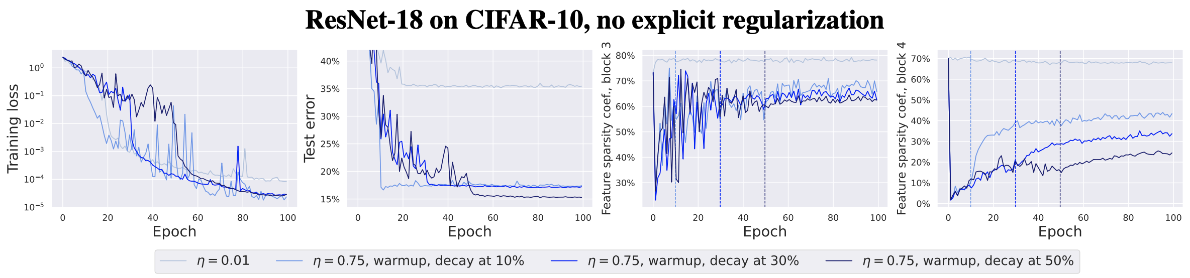
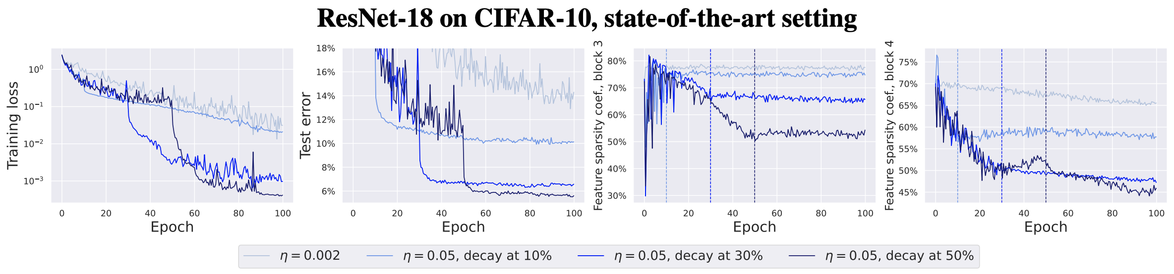
Sparse feature learning for deep networks
Notes:
We see the same sparse feature learning pattern on all models we consider, incl. ResNets on CIFAR-10/100. We can’t compute rank(ϕ(X)) for them but the features at the middle/last layers become *much* sparser for large step sizes (with and without explicit regularizers).

Slide 19




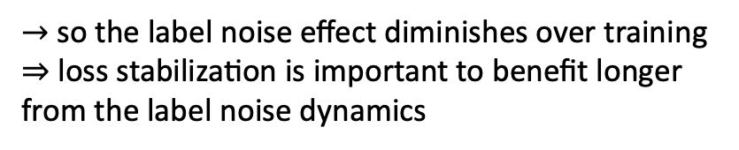
SGD is exactly GD + specific label noise
Standard SGD:
$→$ assume the square loss for simplicity
Specific label noise:
$→$ this label noise + GD is equivalent to SGD
Scale of this noise:
$→$ so the label noise effect diminishes over training ⇒ loss stabilization is important to benefit longer from the label noise dynamics
When the loss stabilizes, we can assume that the noise intensity is constant
Then SGD is equivalent to GD + constant label noise, and this modeling can be leveraged to capture dynamics of large step size SGD
Notes:
First, SGD can be seen as GD + specific label noise whose strength scales with training loss.

Slide 20
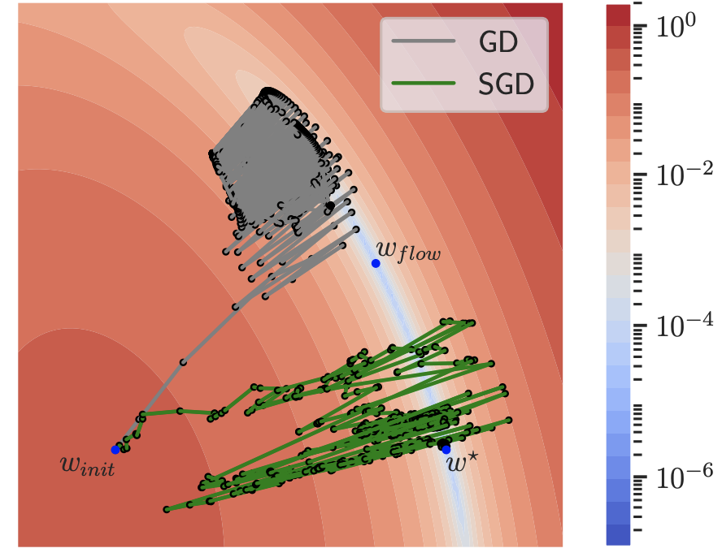
… but in general not simply with full-batch GD + large step sizes
Model: diagonal linear networks
Notes:
Some takeaways:

