Slide 1
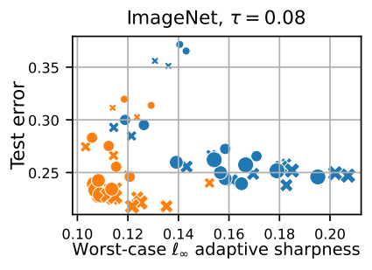
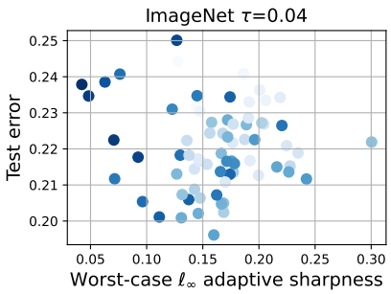
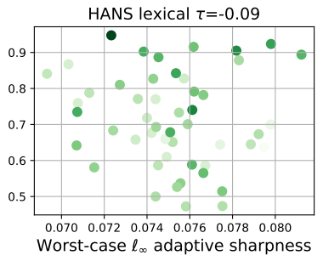
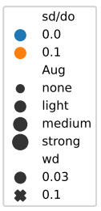
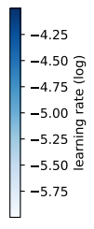
A modern look at the relationship between sharpness and generalization
Maksym Andriushchenko (EPFL), Francesco Croce (U of Tübingen), Maximilian Müller (U of Tübingen), Matthias Hein (U of Tübingen), Nicolas Flammarion (EPFL)
Question: Can reparametrization-invariant sharpness capture generalization in modern practical settings?
Training ViT from scratch
Fine-tuning CLIP ViT
Fine-tuning BERT models
⚠️ Correlation τ ≈ 0
⚠️ Correlation τ ≈ 0
⚠️ Correlation τ ≈ 0
13 March 2023, OOD robustness + generalization reading group (CMU)

Slide 2
Big picture: understanding the generalization puzzle in overparametrized deep learning
Different global minima can generalize very differently e.g., see “Bad Global Minima Exist and SGD Can Reach Them” (Liu et al. NeurIPS’19)
What measure computed on the training set can distinguish the minima which generalize well?
Can we figure this measure and optimize it for training? (+ use it as a tool to understand the generalization puzzle)

Slide 3
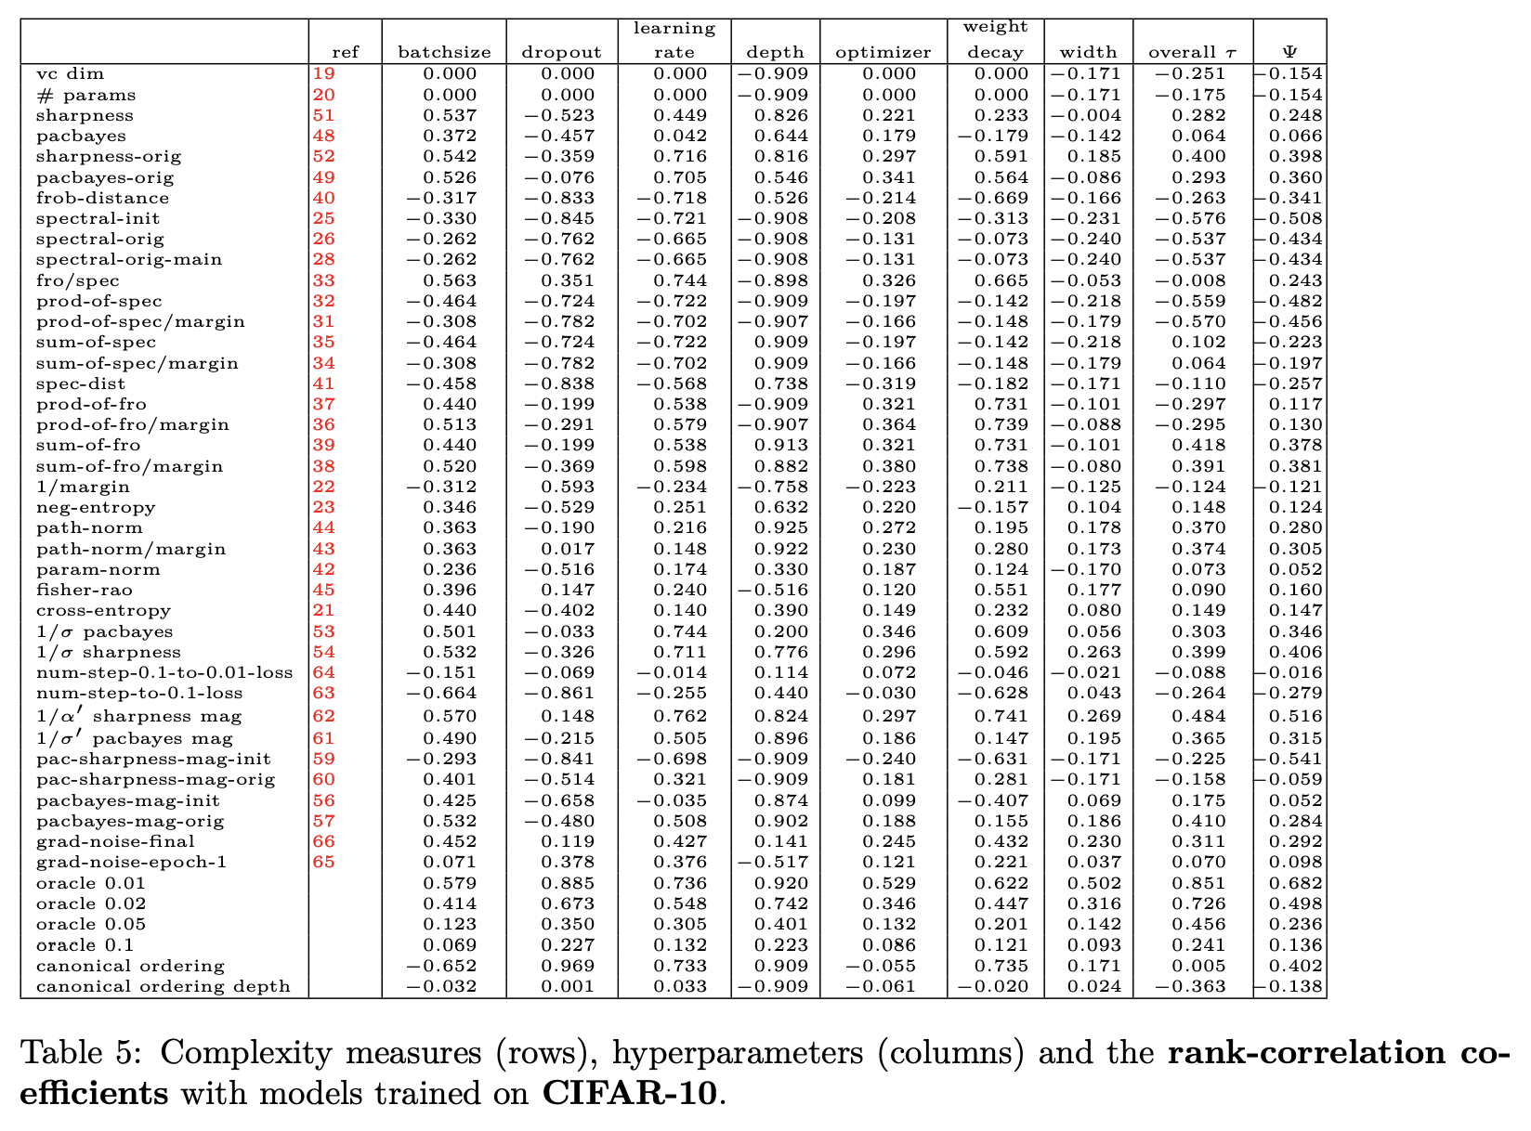
Prior work: finding such measures is actually not easy!
Main ref: “Fantastic Generalization Measures and Where to Find Them” (Jiang et al., ICLR’20) which highlights sharpness as a promising measure
What can we expect from such measure:
Causal relation: smaller measure $⇒$ better generalization (universally)
Correlation: smaller measure $⇒$ better generalization (but there may exist counterexamples)
Sufficient but not necessary: small measure $⇒$ good generalization; large measure $⇒$ can’t say anything
We will focus on 2. and 3. showing they don’t hold for sharpness (this will also rule out 1.)
Notes:
Many papers assume causal relation!

Slide 4
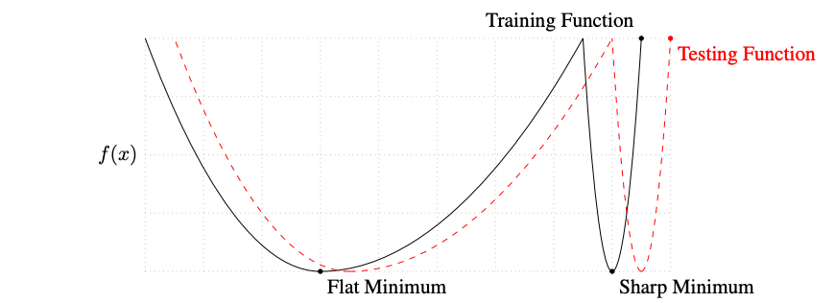
Flat vs. sharp minima: intuition
Popular intuition: the test loss will be close to the training loss for a flat minimum
(can be OOD)
Source: “On Large-Batch Training for Deep Learning: Generalization Gap and Sharp Minima” (Keskar et al., ICLR’17)
Keskar et al., ICLR’17: small-batch SGD converges to flat minima unlike large-batch SGD
Sharpness also received renewed interest with the Edge of Stability phenomenon and the empirical success of Sharpness-Aware Minimization

Slide 5
Flat vs. sharp minima: theory
There are generalization bounds based on sharpness
perturbed population loss
perturbed training loss
term that depends on the scale of the predictor
But they can be often of limited use as illustrated well by Jiang et al., ICLR’20
τ = rank correlation coefficient:
While there exist networks for which these bounds can be quite tight (Lotfi et al., NeurIPS’22), this doesn’t apply to all possible networks $⇒$these quantities are not necessarily meaningful to solve the generalization puzzle

Slide 6
Problems with the standard sharpness definitions
$$Tr(∇_{w}^{2} L(f_{w}))$$
$$λ_{max} (∇_{w}^{2} L(f_{w}))$$
Keskar et al., ICLR’17 + many other papers
Keskar et al., ICLR’17, Damian et al., NeurIPS’21 + many other papers
Keskar et al., ICLR’17, + many other papers
Main problem (Dinh et al., ICML’17): lack of invariance to layerwise rescaling: $\frac{1}{β}V⋅σ\left(βWx\right)=V⋅σ\left(Wx\right)$ (for a homogeneous $σ$) $⇒$ same network but with different sharpness!
However, this is pretty easy to fix: adaptive sharpness is invariant to such rescaling and is reported to correlate better with generalization “ASAM: Adaptive Sharpness-Aware Minimization for Scale-Invariant Learning of Deep Neural Networks” (Kwon et al., ICML’21)

Slide 7
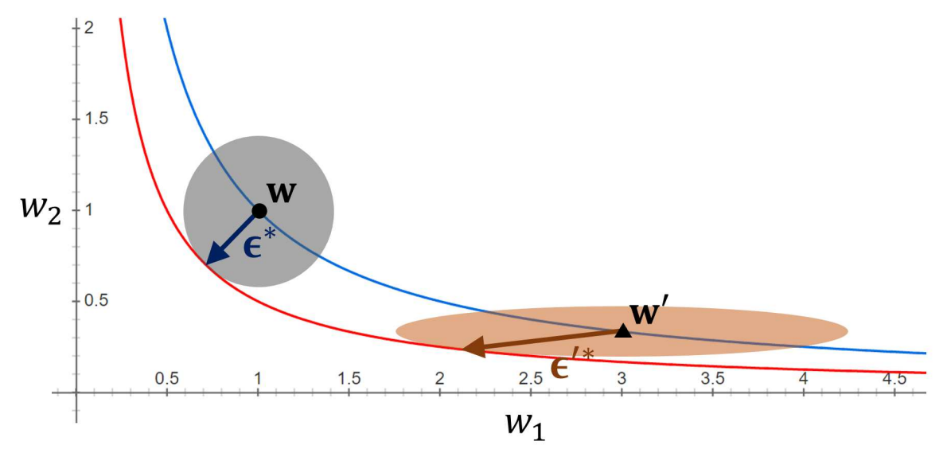
Adaptive sharpness: definition
Average-case sharpness:
Worst-case sharpness:
Choosing $c≔|w|$ leads to adaptive sharpness $S(w, |w|)$which ensures that for any $γ∈ℝ^{p}$ such that $f\left(w⊙γ\right)=f(w)$: $S\left(w⊙γ, |w⊙γ|\right)=S(w, |w|)$
This also covers normalization layers (BatchNorm, LayerNorm) and makes sharpness reparametrization-invariant for the whole modern networks (ResNets / ViTs)
Source: Kwon et al., ICML’21
for a proof: see our paper or Kwon et al.
Notes:
Adaptive sharpness: note that avg-case rho -> 0 sharpness resembles a lot relative sharpness (same core idea => many proposals in the literature)

Slide 8
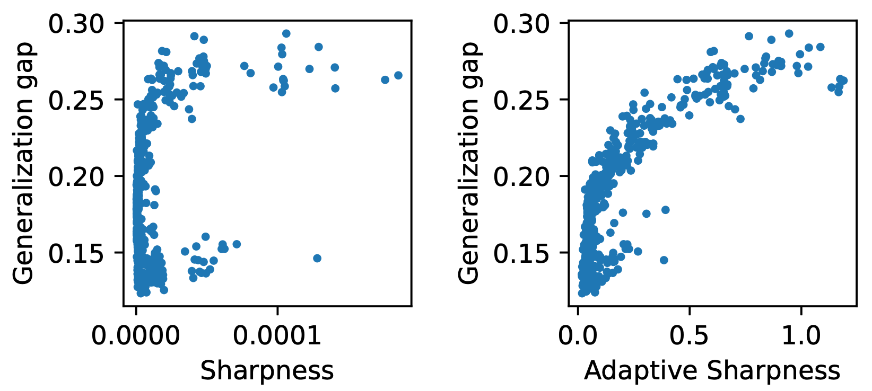
Adaptive sharpness: better correlation with generalization
Adaptive sharpness is reported to correlate better with generalization (setting: WideResNet-16-8 on CIFAR-10)
τ = 0.174
τ = 0.636
“ASAM: Adaptive Sharpness-Aware Minimization for Scale-Invariant Learning of Deep Neural Networks” (Kwon et al., ICML’21)
Very nice, no? Is adaptive sharpness the answer to the generalization puzzle?

Slide 9
Motivation of our work
Main question we want to answer: Can adaptive sharpness capture generalization in modern practical settings?
What we mean by modern practical settings:
datasets beyond toyish CIFAR-10 / SVHN,
vision transformers,
fine-tuning (totally underexplored),
out-of-distribution generalization.
We want to have a definite answer about whether sharpness is the right quantity!
Notes:
Adaptive sharpness: note that avg-case rho -> 0 sharpness resembles a lot relative sharpness (same core idea => many proposals in the literature)

Slide 10
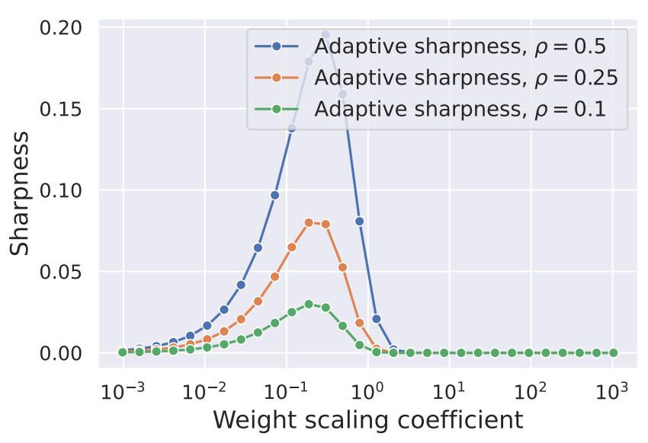
Another concern: sensitivity to the scale of the classifier
Sharpness is strange for classification: scaling the logits by $α≥0$ will preserve the classifier but can arbitrarily change sharpness
Adaptive sharpness is no exception: you can keep optimizing the cross-entropy loss and this will drive adaptive sharpness to 0
Linear model that achieves 100% train accuracy
This is well illustrated on linear models: $w^{′}←αw$
Possible solution: logit normalization
We will benchmark all sharpness definitions with and without logit normalization

Slide 11
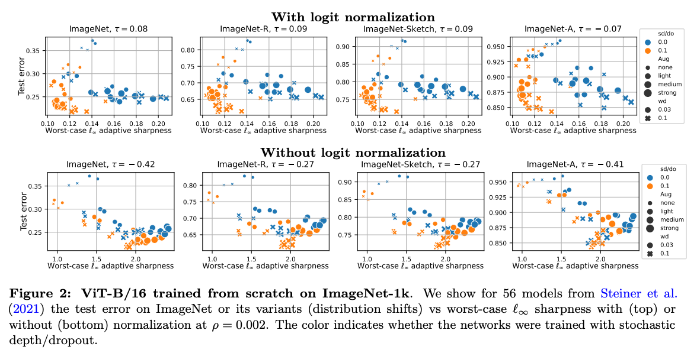
Setting #1: ViTs trained from scratch on ImageNet
The correlation (τ) is either close to 0 or even slightly negative (-0.42 for ImageNet-A)!

Slide 12
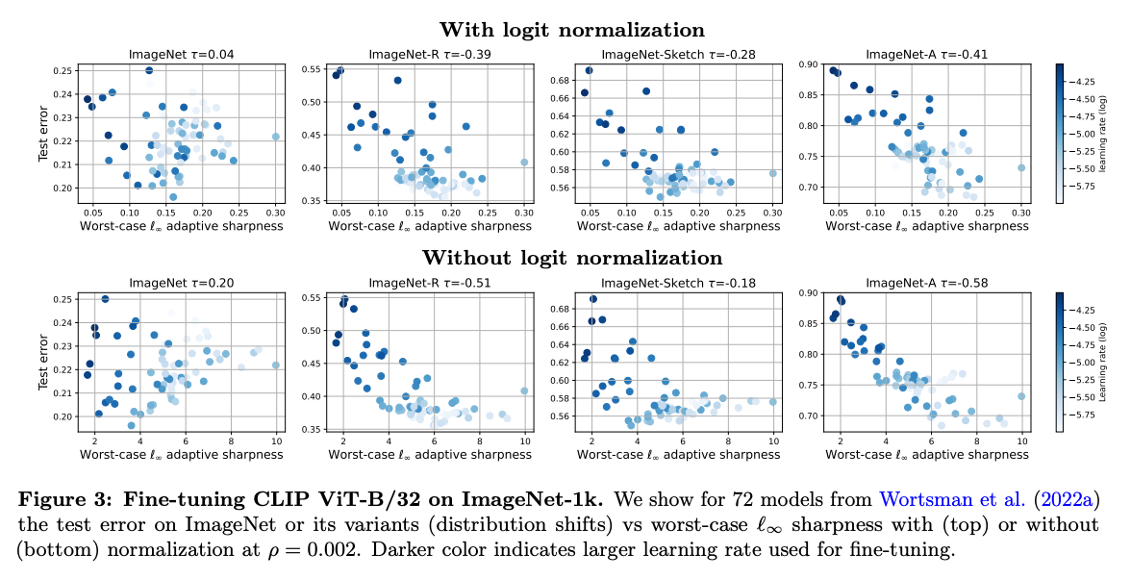
Setting #2: ViTs fine-tuned from CLIP on ImageNet
The correlation is again either close to 0 or negative, especially on distribution shifts like ImageNet-R and ImageNet-A (as low as -0.51 and -0.58!)

Slide 13
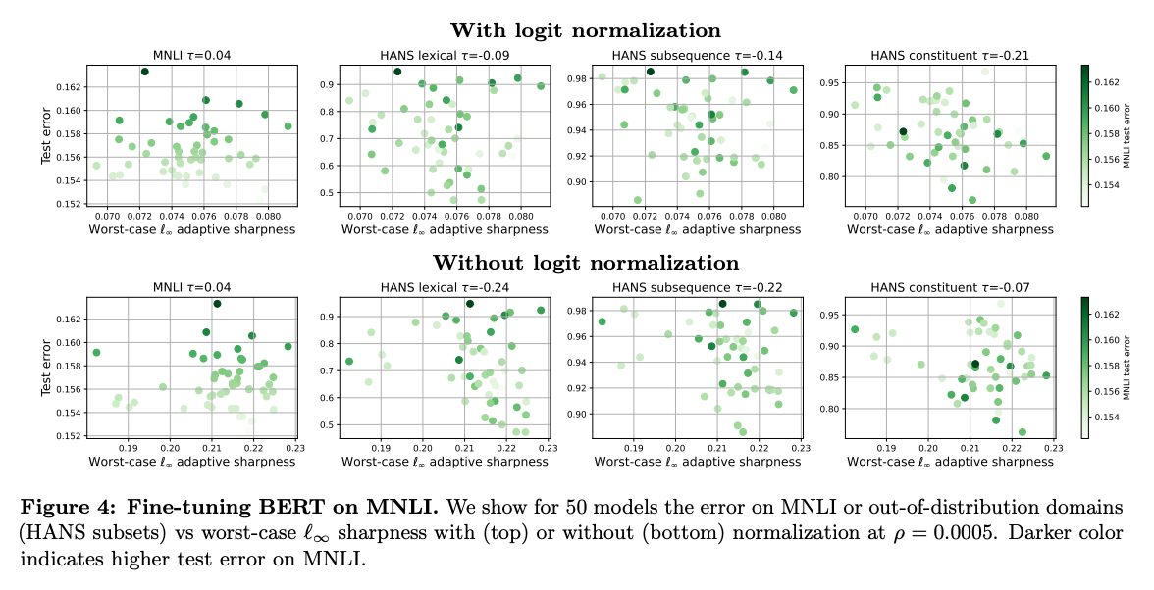
Setting #3: BERT models fine-tuned on MNLI
This case is famous since OOD generalization (see HANS lexical) can be very different
However, sharpness is not helpful to distinguish which solutions will generalize better for OOD

Slide 14
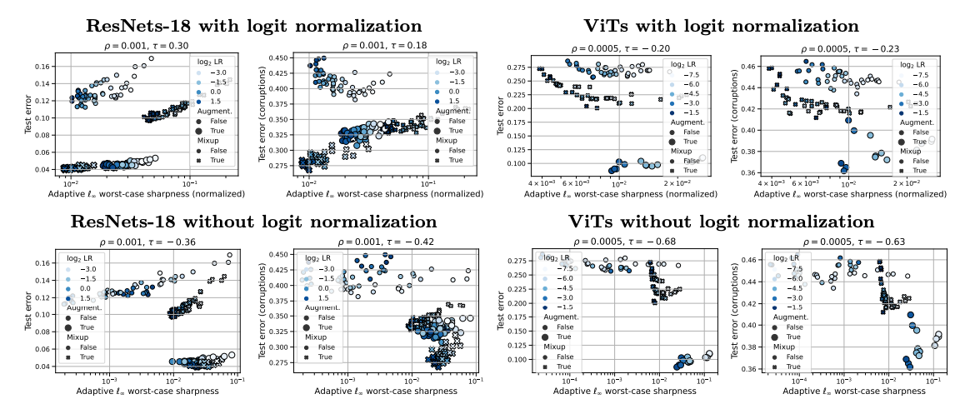
Setting #4: ResNets and ViTs trained from scratch on CIFAR-10
Maybe sharpness has to be measured close to a min? select only models ≤1% train error
Positive correlation is present but only within subgroups of models trained with the same augmentations
Globally, however, correlation is either close to 0 or negative (as much as -0.68!)

Slide 15
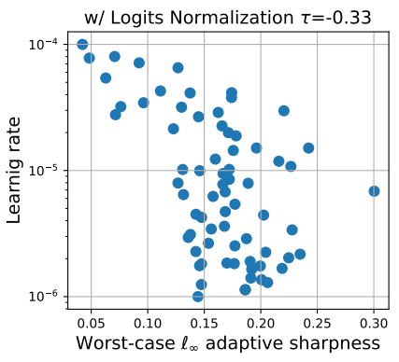
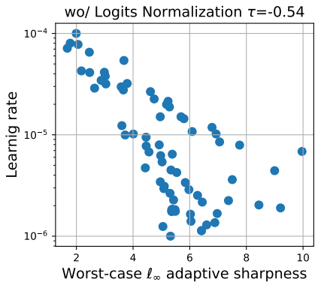
So what does sharpness really capture?
Overall, we observe that sharpness doesn't correlate well with generalization but rather with some training parameters like the learning rate
Training ResNet from scratch
Finetuning ViT on ImageNet
However, the learning rate can positively or negatively correlate with generalization depending on the setup
Roughly speaking: large LRs are good for pretraining (at least for CNNs), small LRs are good for fine-tuning

Slide 16
Is sharpness the right quantity in the first place? Theoretical insights
Simple model: sparse regression with a diagonal linear network $β≔u⊙v$
for $L\left(w\right)=0$and $X^{⊤}X=I$:
For appropriate adaptive sharpness with $c_{i}=\sqrt{\left|v_{i}\right|/|u_{i}|}$ for $1≤i≤d$ and $c_{i}=\sqrt{\left|u_{i}\right|/|v_{i}|}$ for $d+1≤i≤2d$
we get for $ρ→0$ that different sharpness definitions capture totally different quantities:
However, we know apriori that for sparse regression only $|\left|β\right|{\left.​\right|}_{1}$ is the right quantity
Thus, only a very specific sharpness definition for this given problem can explain generalization

Slide 17
What can go wrong with the sharpness definition?
Empirical validation: a bunch of diagonal linear nets trained with different LR and init
Our analysis suggests that sharpness can be the right quantity
However, choosing the right definition of sharpness requires a precise understanding of the data and how it interacts with the architecture
This is obviously challenging beyond toy models!

Slide 18
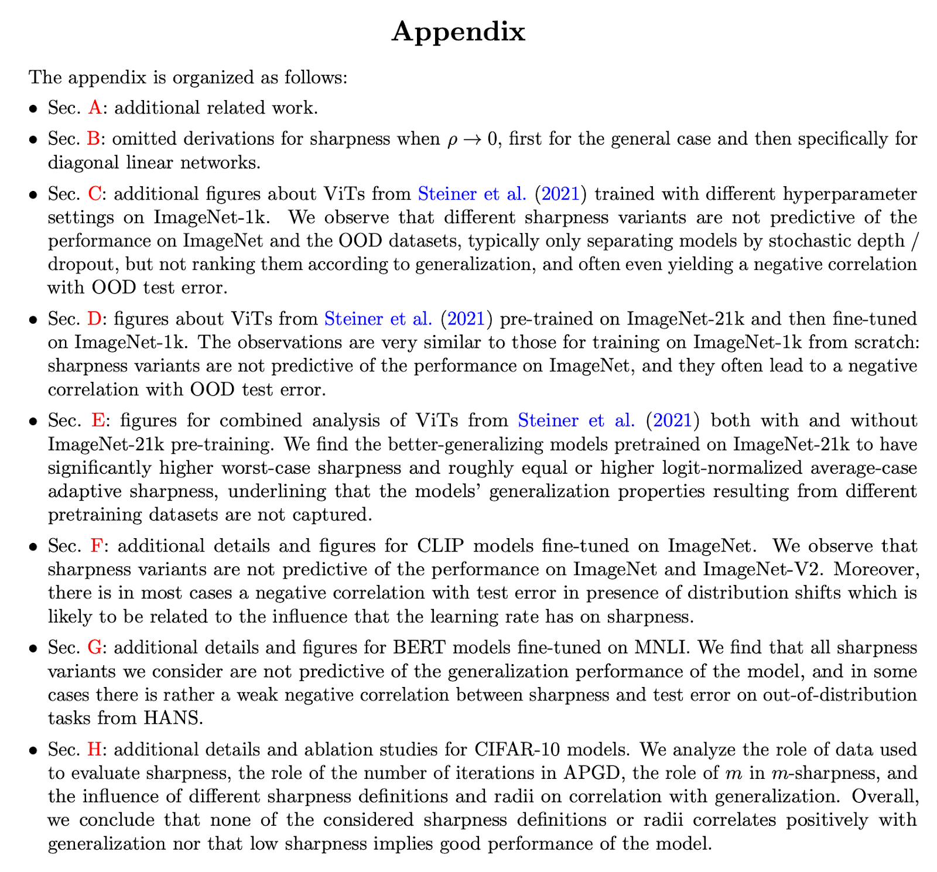
Note: lots of experiments in the appendix
We tried many-many sharpness definitions ($ℓ_{2}$ vs. $ℓ_{∞}$ norms, avg- vs. worst-case, with/without normalization, adaptive vs. non-adaptive sharpness)
50+ pages of appendix!
We hope we answered the question comprehensively

Slide 19
Outlook
Is it even possible to have a single measure that would be causally related to generalization?
I think it’s highly unlikely and too good to be true (as the DLN example illustrates: this depends a lot on the data distribution)
But: there are some creative proposals like computing disagreement on unlabeled data which correlates pretty well with generalization
However, for this, we need at least a small amount of unseen unlabeled data… then why not assuming that we have unseen labeled data?
Regarding the success of sharpness-aware minimization: it must be a combination of sharpness with some implicit bias of (S)GD that we don’t quite understand
Thanks for your attention!
Happy to discuss more :)

Slide 20
Relation of these findings to methods that opimize sharpness
SAM minimizes worst-case sharpness during training. Randomized smoothing / Anti-PGD optimizes average-case sharpness.
Must be an implicit bias! We need to analyze the whole training dynamics of SAM, not just the end point at a minimum.
New paper on that: SAM operates far from home: eigenvalue regularization as a dynamical phenomenon (arXiv, Feb 2023)

Slide 21
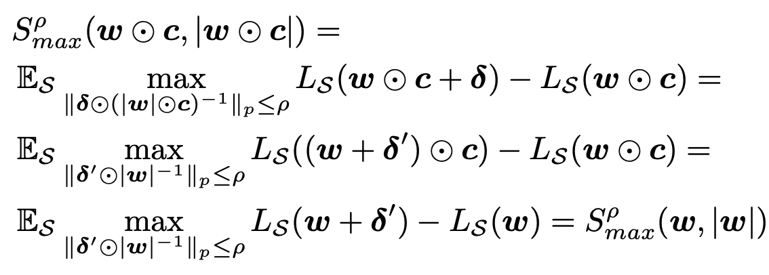
Backup slides
For any $c∈ℝ^{p}$ such that $f\left(w⊙c\right)=f\left(w\right)$, we have:

